Slide 1
FNR 59800-018 Intro to R Programming
PFEN 202
Mon, Tue, Thu 8:30-12:20; Fri 12:20-2:20

Slide 2
Day 2 plan
Data exploration
Plotting
Exploration and plotting exercise
Work on Projects

Slide 3
Data Exploration

Slide 4
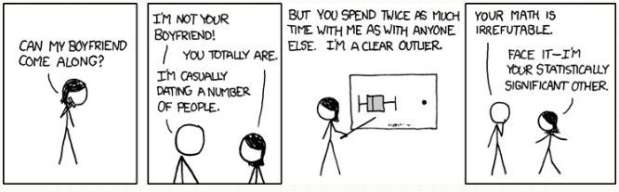
Why?
Summarizing the main characteristics of a data set prior to any statistical analyses
Detect unusual values
Understand the structure of the data
Decide best way to answer main questions
Formulate new questions

Slide 5
Central Tendency
Mean- sum of all values divided by the number of values in the data set
mean(vector)
Median- middle value
median(vector)
Mode- most commonly occurring value

Slide 6
Variation
Range- lowest and highest values in a data set
range(vector)
Variance- average of the squared differences from the mean
var(vector)
Standard deviation- square root of the variance
sd(vector)
Standard error- standard deviation divided by the square root of the sample size

Slide 7
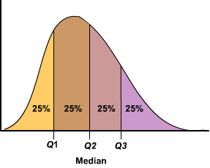
Quantiles
Cutpoints dividing a variable into equal intervals
quartiles (0.25, 0.5, 0.75)
quantile(vector, prob)

Slide 8
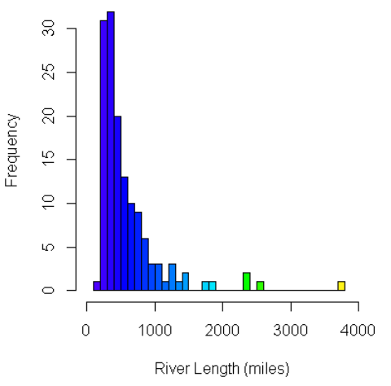
Histogram
Graphical representation of the distribution of numerical data
hist(vector, breaks)

Slide 9
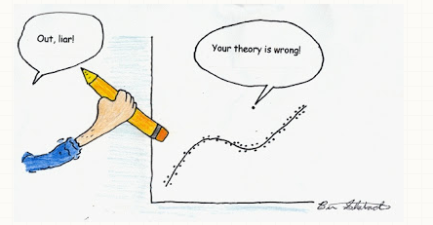
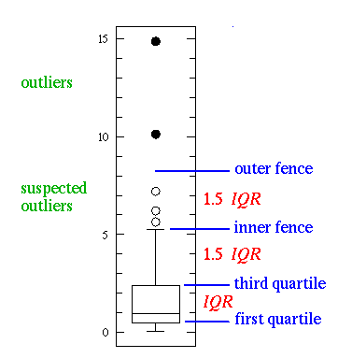
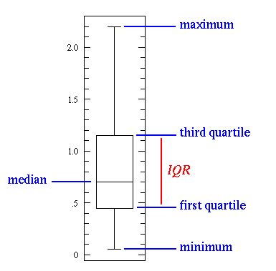
Box Plot
Box plot- a.k.a. box and whisker plot
boxplot(vector)

Slide 10
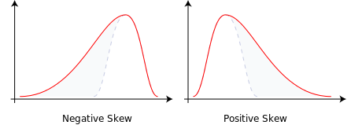
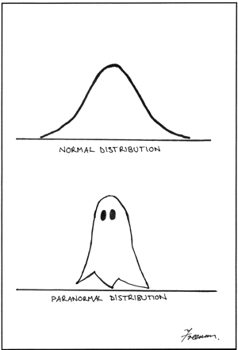
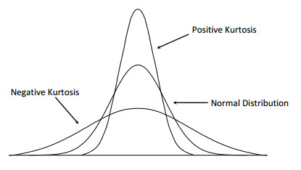
Normality
Skewness- measure of the assymetry of a distribution
normal=0
skewness(vector) #moments package
Kurtosis- measure of the shape of a distribution
normal = 3
kurtosis(vector)#moments package
Shapiro-Wilk test
shapiro.test(vector)

Slide 11
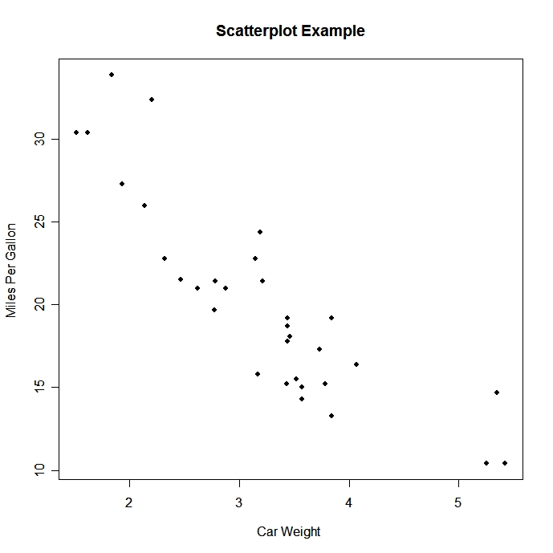
Scatter Plot
Shows relationship between two sets of data
plot(x,y )

Slide 12
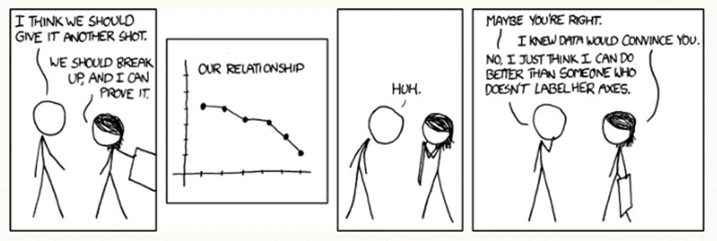
Standardization
Variable rescaled to have a mean of zero and standard deviation of one
a.k.a. z-score
For each value subtract the mean and divide by the standard deviation
scale(vector)

Slide 13
Data visualization

Slide 14
Data visualization
Objective
To be able to make basic types of plots using functions in R
Selecting appropriate type of plots
a. Check the explanatory variable
b. If the explanatory variable is continuous: scatterplot
c. If the explanatory variable is categorical: boxplot, barplot

Slide 15
Scatter plot
plot(x, y)or plot(y~x)
x: explanatory variable
y: response variable
x and y should be continuous variable

Slide 16
Scatter plot
##### generate sample data
x1<-runif(20, 5, 15) # generate 20 random numbers between 5 and 15 with an uniform distribution
x2<-runif(20, 5, 20) # generate 20 random numbers between 10 and 20 with an uniform distribution
y1<-rnorm(20, 100, 10) # generate 20 random numbers with a normal distribution of mean 100 and standard deviation 10.
y2<-rnorm(20, 120, 10) # generate 20 random numbers with a normal distribution of mean 120 and standard deviation 10.
s<-c(rep("A", 10), rep("B", 10)) # generate a categorical variable

Slide 17
Scatter plot
##### create a dataframe
sample_dat<-as.data.frame(cbind(x1, x2, y1, y2,s)) # combine all variables into a data frame
sample_dat$x1<-as.numeric(as.character(sample_dat$x1)) # change variable x1 as numeric
sample_dat$x2<-as.numeric(as.character(sample_dat$x2)) # change variable x2 as numeric
sample_dat$y1<-as.numeric(as.character(sample_dat$y1)) # change variable y1 as numeric
sample_dat$y2<-as.numeric(as.character(sample_dat$y2)) # change variable y2 as numeric
colnames(sample_dat)<-c("X1", "X2", "Y1", "Y2", "S") # change variable names (column names)

Slide 18
Scatter plot
##### setting a panel for multiple figures
par(mfrow=c(3,2)) # number of rows=3, number of column=2
##### create a scatter plot
plot(x1, y1)
plot(y1~x1)
plot(Y1~X1, data=sample_dat)
plot(sample_dat$Y1~sample_dat$X1)
plot(sample_dat[,3]~sample_dat[,1])

Slide 19
##### plotting with log scale
plot(Y1~X1, data=sample_dat)
plot(Y1~X1, data=sample_dat, log='xy')
plot(Y1~X1, data=sample_dat, log='y')
plot(Y1~X1, data=sample_dat, log='x')
##### labeling x and y axes
plot(Y1~X1, data=sample_dat, xlab="Axis X1", ylab="Axis Y1")
##### adding figure title
plot(Y1~X1, data=sample_dat, xlab="Axis X1", ylab="Axis Y1", main="Exercise")

Slide 20
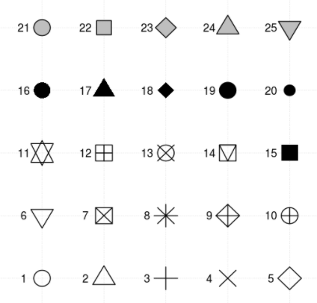
##### setting x and y axis range
plot(Y1~X1, data=sample_dat, xlab="Axis X1", ylab="Axis Y1", xlim=c(0,10), ylim=c(0, 10))
##### change point type and color
plot(Y1~X1, data=sample_dat, xlab="Axis X1", ylab="Axis Y1", pch=15)
plot(Y1~X1, data=sample_dat, xlab="Axis X1", ylab="Axis Y1", pch=15, col="orange")
Point type
Line type

Slide 21
##### multiple relationships in a single plot
plot(Y1~X1, data=sample_dat, xlab="Axis X1", ylab="Axis Y1")
par(new=T)
plot(Y2~X2, data=sample_dat, xlab="Axis X2", ylab="Axis Y2")
range(sample_dat$X1)
range(sample_dat$X2)
range(sample_dat$Y1)
range(sample_dat$Y2)

Slide 22
# option 1
plot(Y1~X1, data=sample_dat, xlab="Axis X", ylab="Axis Y", xlim=c(5,20), ylim=c(80, 150), pch=15, col="red", main="Exercise")
par(new=T)
plot(Y2~X2, data=sample_dat, xlab="", ylab="", xlim=c(5,20), ylim=c(80, 150), axes=F, pch=19, col="blue")
# option 2
plot(Y1~X1, data=sample_dat, xlab="Axis X", ylab="Axis Y", xlim=c(5,20), ylim=c(80, 150), pch=15, col="red", main="Exercise")
points(Y2~X2, data=sample_dat, pch=19, col="blue")

Slide 23
##### adding regression line
lm(Y1~X1, data=sample_dat)
lm(Y2~X2, data=sample_dat)
abline(lm(Y1~X1, data=sample_dat), col="red", lty=2)
abline(lm(Y2~X2, data=sample_dat), col="blue", lty=3)
##### adding legend
legend("bottomright", pch=c(15, 19), col=c("red", "blue"), legend=c("data1", "data2"))

Slide 24
Boxplot
boxplot(y~x)
y: continuous variable
x: group

Slide 25
Boxplot
##### create a boxplot
boxplot(X1~S, data=sample_dat, col=c("tomato2", "dodgerblue4"), ylab="X1", xlab="S", pch=19)

Slide 26
Barplot
barplot(x)
x: height

Slide 27
Barplot
##### create a barplot
mean<-tapply(sample_dat$Y1, sample_dat$S, mean)
sd<-tapply(sample_dat$Y1, sample_dat$S, sd)
nbr<-tapply(sample_dat$Y1, sample_dat$S, length)
se<-sd/sqrt(nbr)
par(mfrow=c(1,1))
barplot(mean, col=c("tomato2", "dodgerblue4"), border=c("tomato2", "dodgerblue4"), ylab="Y1", ylim=c(0, 120))

Slide 28
Barplot
##### adding error bars
xx<-barplot(mean, col=c("tomato2", "dodgerblue4"), border=c("tomato2", "dodgerblue4"), ylab="Y1", ylim=c(0, 120))
arrows(xx, mean, xx, mean+sd, angle=90, col=c("tomato2", "dodgerblue4"), lwd=2)

Slide 29
Saving the graphics
pdf(“file location”, width=7, height=4) # Start new device
par(mfrow=c(1,2)) # panel figures
plot() # plot
dev.off() # Terminate the device

